Slide 1
CM 1607 ENGLISH COMMUNICATION SKILLS
Lecture 5
Verbs & Adverbs
Paragraph and Essay writing (descriptive, narrative, persuasive, expository, analytical)

Slide 2

Verbs and Adverbs - recall
A verb tells about an action or a state.
It is the main part of a sentence: every sentence has a verb.
In English, verbs are the only kind of word that changes to show past or present tense.
There are sixteen verbs used in Basic English.
E.g. Come, comes, came
want, wants, wanted
say, says, said

Slide 3
Adverbs - video
Let’s watch this video on Adverbs
https://www.youtube.com/watch?v=L0USJe44yS4

Slide 4
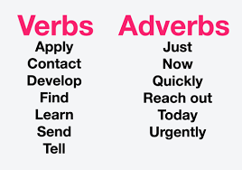
Verbs & adverbs (Cont’d …)
Practice activities on verbs and activities will be done in Tutorial 5.

Slide 5

Paragraph and Essay writing
Let’s take a look at Lecture 5 Handout 1, Activity 1.
Time to move on to Essay writing.
Very quickly tell the class what are the types of Essays you have written
or heard about.
Let’s check some answers.

Slide 6
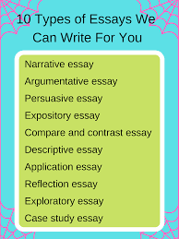
Essay Writing

Slide 7
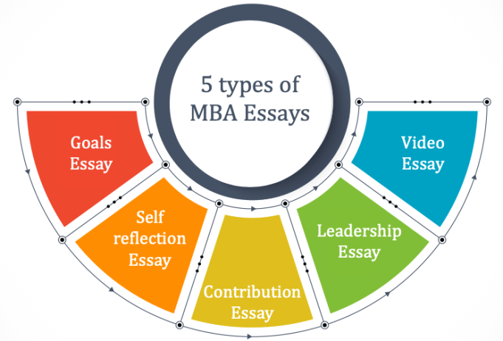
Take a look at some MBA essay topics:
Now, let’s look at handout 2 for more details about MBA essays

